Slide 1
B.TECH PROJECT SUMMARY
Database Management System for Cooperative Society Membership and Savings Management.
A relational database project for cooperative membership and savings management.
Daibala Sowmya · 25WU0102331
Woxsen University · School of Technology
DATABASE SYSTEMS

Slide 2
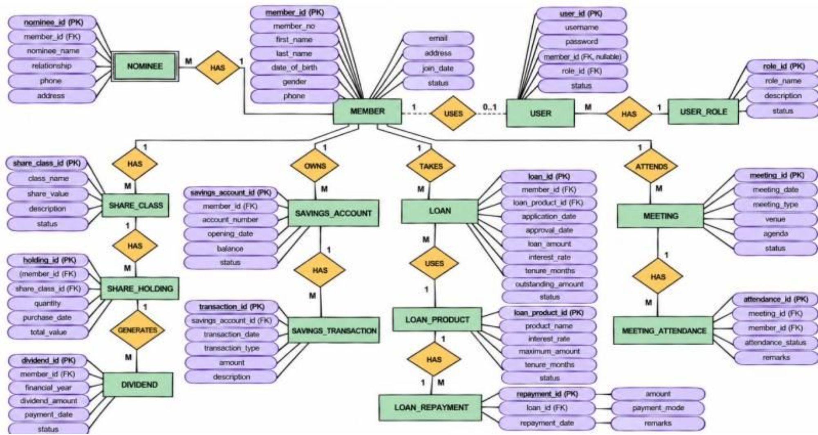
01 · RELATIONAL MODEL
A relational model connects members to cooperative services
MEMBER anchors the model; related tables organize transactions and participation.
Core domains: membership, savings, loans, shares, dividends, meetings, and access roles.
The report describes normalization through Third Normal Form and derived interest calculations.
02

Slide 3


02 · IMPLEMENTATION
MySQL and a connected interface support core operations
UI screenshot · sign-in prototype example (not verified production)
UI screenshot · member-records prototype example (not verified production)
01
02
Role-based access
Core operations
Member and staff workflows are described.
Inserting, deleting, viewing, and querying records.
Reported stack
MySQL
Python
HTML/CSS
03
04
Reported tests
Future work
Sample queries supported savings, loans, dividends, and meeting records.
Stronger security, payment integration, cloud deployment, and analytics.
03

Slide 4
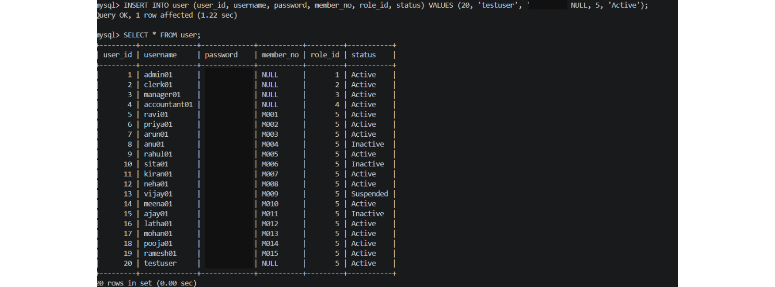
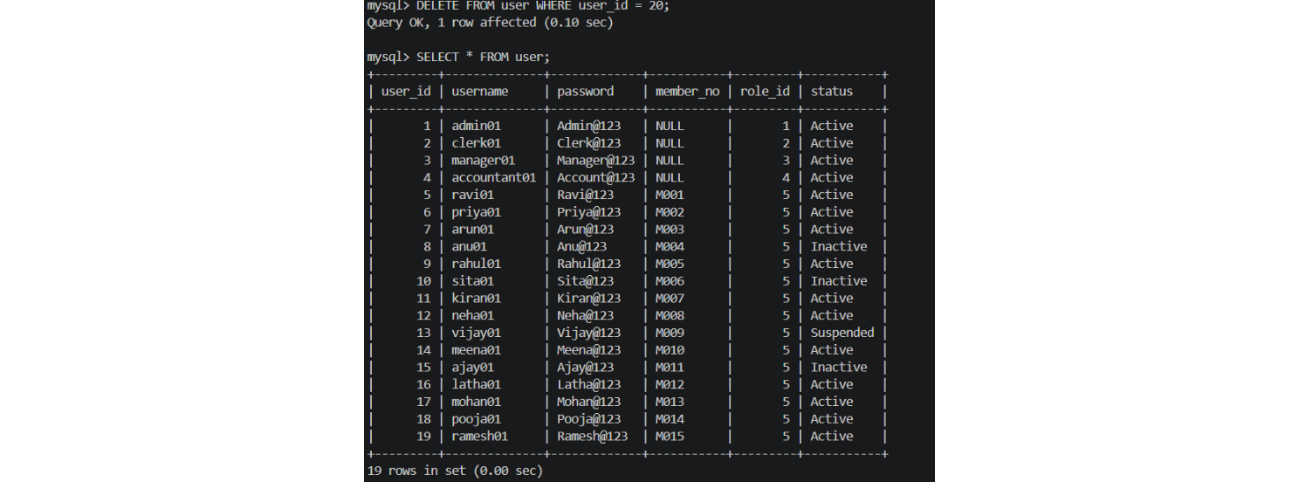
03 · SQL EXAMPLES
Sample INSERT, SELECT, and DELETE outputs
Illustrative query results from the cooperative society database.
Sample INSERT/SELECT output screenshot · password value redacted
Sample DELETE/SELECT output screenshot
04

